Slide 1
Optimizing Large Language Models for Specific Tasks
Kyle Henry

Slide 2
Agenda
The Problem
Areas of Study
Pruning
Knowledge Distillation
Quantization
PEFT
Experimentation
Conclusion

Slide 3

The Problem

Slide 4
The Problem
LLMs have inherit tasks they have learned through training
LLMs are powerful tools that can be used for many text-based problems
LLMs are massive, requiring a lot of resources/capital to run

Slide 5
Areas of Study

Slide 6
Areas of Study
Pruning
Knowledge Distillation
Quantization
PEFT

Slide 7
Pruning
Used to reduce the number of parameters by removing redundant or unused parameters
Speed ups are dependent on the technique
Wanda
Layer Pruning
Hit or Miss when implemented

Slide 8
Knowledge Distillation
“Transfers” knowledge by training a smaller student model with the help of a larger teacher model
Use a dataset in conjunction with the teachers output to train the student
Marginal performance increase for the smaller model

Slide 9
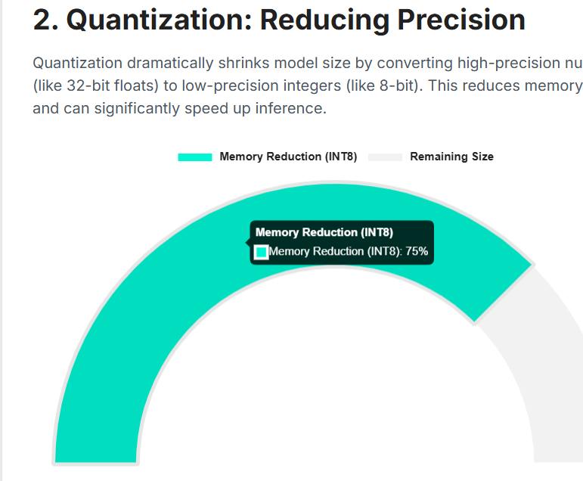
Quantization
Reduces size of model inherently by reducing the precision of the parameters.
FP32 -> INT8

Slide 10
PEFT: Parameter Efficient Fine-Tuning
Trains a subset of a LLM
Can be combined with Quantization to get peak performance
LoRA (Low-Rank Adaptation) is the leading methodology for doing this.

Slide 11
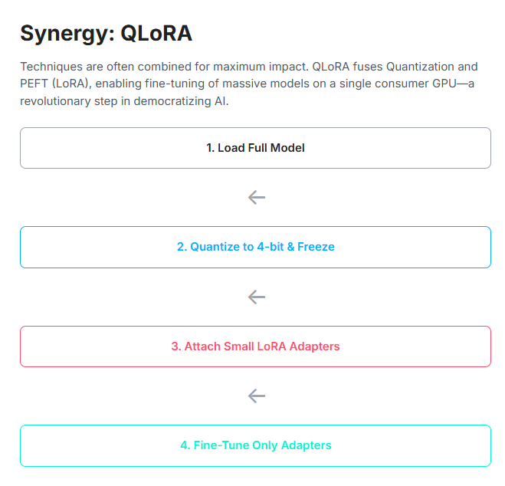
Current Optimization Goal

Slide 12
Experimentation

Slide 13
Conclusion

Slide 14
Citations
Lottery Ticket Hypothesis," Jonathan Frankle
Reassessing Layer Pruning in LLMs: New Insights and Methods
https://www.ibm.com/think/topics/quantization
"LoRA: Low-Rank Adaptation of Large Language Models" https://arxiv.org/abs/2106.09685

